Slide 1
iGem-Team Heidelberg 09
Setting new Standards in mammalian cells

Slide 2
The idea
We want to quantify the activity of multiple signaling pathways in individual mammalian cells
Why?
Normal single cell assays quantify one signaling pathway at a time > no information about relation of different pathways
we develop a quantitative reporter system that can monitor multiple signals at once
Natural promotor genes are unspecific
We generate a synthetic system that is specific for its signaling pathway
iGem wants to move forward into eucaryotic cells
we develop a new standard for BioBricks in a mammalian cell system
TM

Slide 3
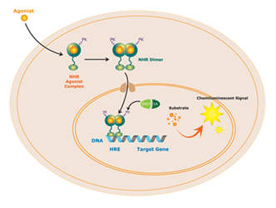
Reporter gene assays

Slide 4
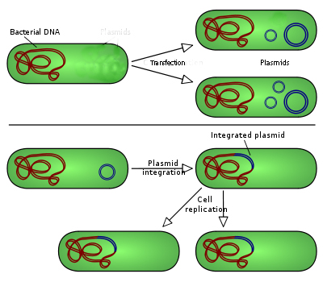
Reporter gene assay is not quantitative
getting the reporter into the cell => one or more plasmids can be
transferred into the cell
=> signal scales with amount of plasmids
stable integration into the genome
=> costs time
=> has to be standardized everytime
standard, controllable way of integration
> Flip-system

Slide 5
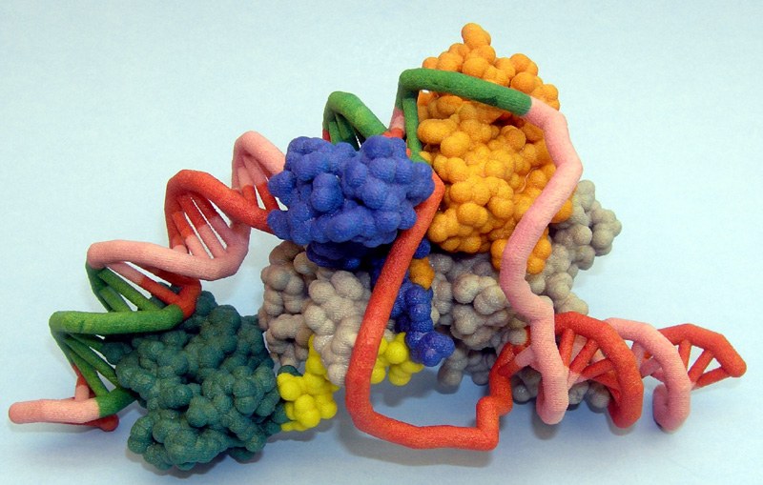
Natural promotors are unspecific
Promoter
Gene
HIF
NF-kB
CREB
+X?
Cell behaviour
Lack of O₂
Hunger
Infection
Factor showing cell state / environment

Slide 6
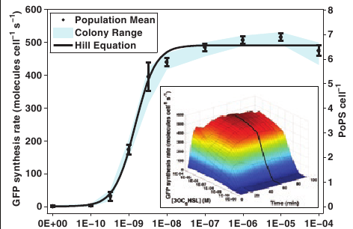
Synthetic promotors provide a quantitative, reliable output
Synthetic Promotor
Fluorescent Protein with targeting sequence
Colour- and compartmet specific output
Single factor
Other factors
Defined strength
d
Oxygen concentration

Slide 7
Strategic design of synthetic promotors

Slide 8
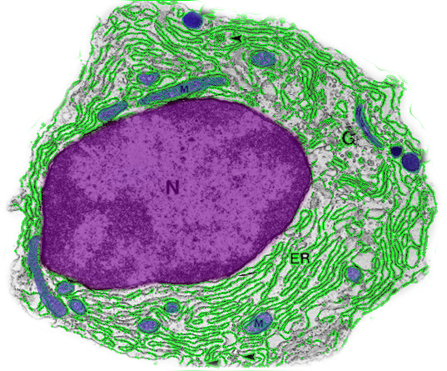
Multiple outputs from one cell
green ER = lack of nutrients
blue Mito = onset of cell death
red Nucleus = lack of Oxygen
blue Nucleus = cell is infected

Slide 9


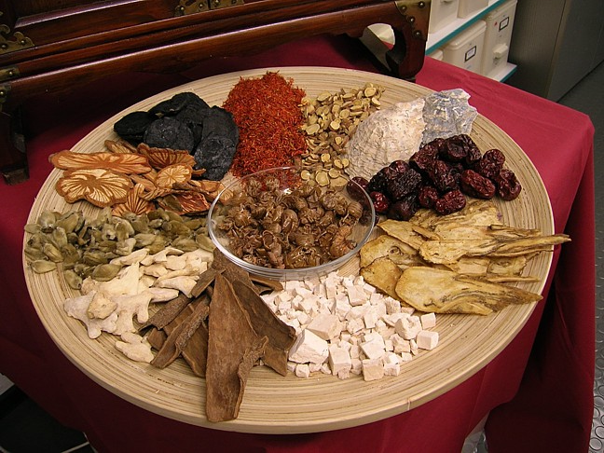
Applications
Test drugs for molecular effect
Identify new drugs

Slide 10
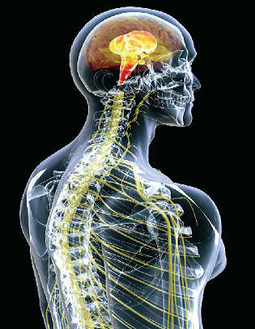
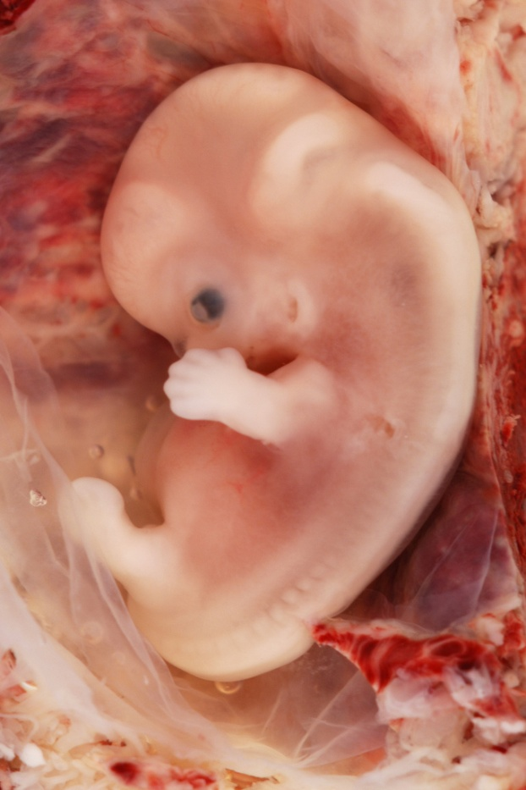
Applications
Molecular mechanisms of cancer development
Molecular mechanisms of embryonic development

Slide 11
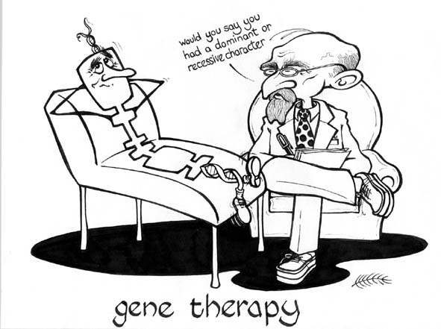
Applications
Gene Therapy!
activate therapy only when necessary
integration of pathway signals

Slide 12




The title
SpyBricks
Standard mammalian Parts which can be used to monitor pathway activities
OR
analysing and exploiting intracellular behaviour / signalling pathways
MammaliaBricks
Spying on intracellular signalling pathways
Or a more serious title ??
Mammalia InitialBricks
Spying on the weirdest cell in the universe
OR
Mammalian Investigator Bricks
FutureBricks
Setting new Standards in mammalian cells

Slide 13
























Slide 14














